Slide 1
Random Forest RegresSion

Slide 2
Random Forest:
A Random forest is a type of ensemble learning algorithm that trains multiple decision trees on random subsets of the data and then combines their prediction to make a final prediction .This can improve the performance of the model compared to using single decision tree
The greater number of trees in the forest leads to higher accuracy and prevents the problem of overfitting.

Slide 3
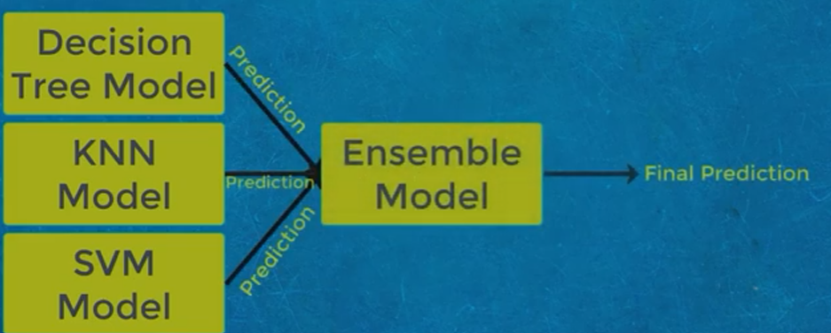
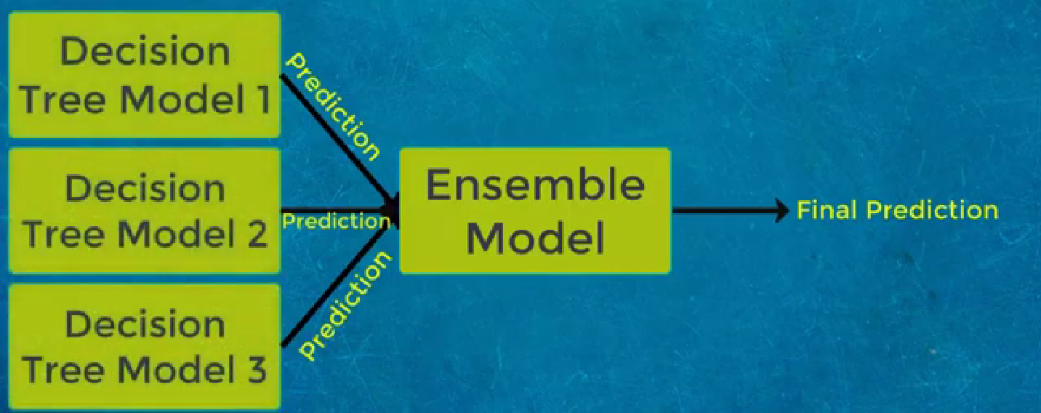
ENSEMBLE LEARNING
Ensemble learning is a technique which take prediction from multiple machine learning algorithm or prediction from same algorithm multiple time, in order to make more accurate prediction.

Slide 4
Types of ensemble technique:
Two type of ensemble techniques:
Bagging
Boosting
Bagging: also known as Bootstrap aggregating ,is a technique used to reduce the variance of decision tree by averaging the results of multiple decision trees trained on different subsets of the data
Boosting: is a technique that combines the predictions of multiple week models to create a strong, more accurate model. The most popular method of boosting is called AdaBoost.

Slide 5
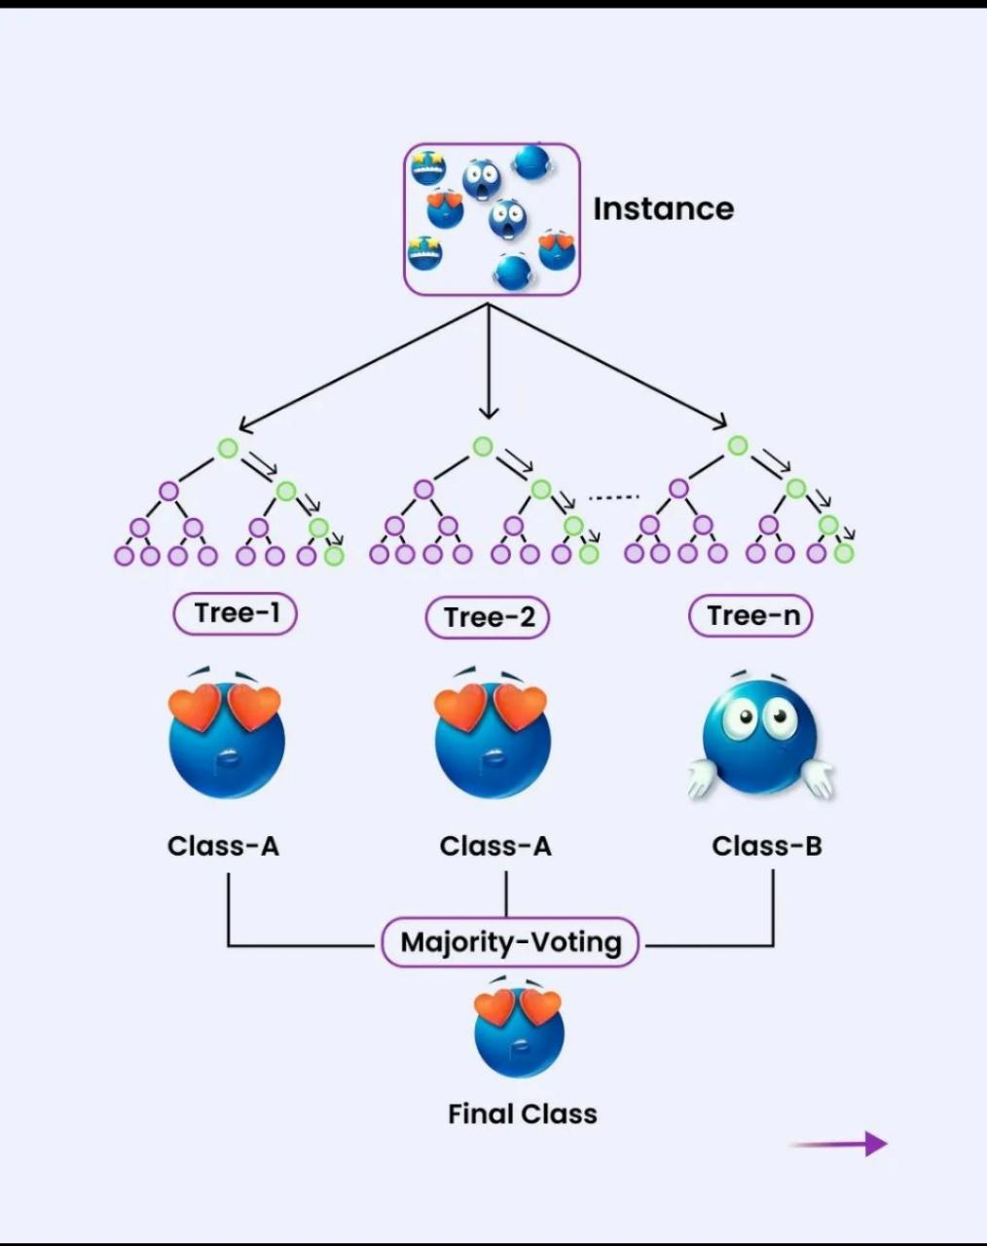

Slide 6
Key points on Random Forest:
A supervised learning algorithm.
Solves both regression and classification problems.
Contains a number of decision trees on various subsets of given dataset and takes their average to improve the accuracy of that dataset.
Handles larges datasets with high dimensionality, takes less training time and also prevents overfitting.
Used in multiple fields for example to detect fraud for bank accounts, drug sensitivity of a medicine, estimated loss or profit while purchasing a stock etc

Slide 7
-- The Random Forest Uses Bagging technique as we known that decision tree leads to overfitting problem, i.e is low Bias and High Variance . In order to avoid high variance the Random Forest is used.
--The Main task of the Random Forest is to convert from High variance to low variance.
--Decision tree is always used in Random Forest.

Slide 8
Random forest regression:
In Every Decision Tree leads to high variance, when we combine with bootstrap aggregates leads to high variance to low variance as each decision tree gets perfectly trained on that particular sample data, and hence the output doesn’t depend on one decision tree but on multiple decision trees. In the case of a classification problem, the final output is taken by using the majority voting classifier. In the case of a regression problem, the final output is the mean of all the outputs.

Slide 9
Random forest regression:
In Every Decision Tree leads to high variance, when we combine with bootstrap aggregates leads to high variance to low variance as each decision tree gets perfectly trained on that particular sample data, and hence the output doesn’t depend on one decision tree but on multiple decision trees. In the case of a classification problem, the final output is taken by using the majority voting classifier. In the case of a regression problem, the final output is the mean of all the outputs.

Slide 10
Random forest regression:
In Every Decision Tree leads to high variance, when we combine with bootstrap aggregates leads to high variance to low variance as each decision tree gets perfectly trained on that particular sample data, and hence the output doesn’t depend on one decision tree but on multiple decision trees. In the case of a classification problem, the final output is taken by using the majority voting classifier. In the case of a regression problem, the final output is the mean of all the outputs.

Slide 11
Random forest regression:
In Every Decision Tree leads to high variance, when we combine with bootstrap aggregates leads to high variance to low variance as each decision tree gets perfectly trained on that particular sample data, and hence the output doesn’t depend on one decision tree but on multiple decision trees. In the case of a classification problem, the final output is taken by using the majority voting classifier. In the case of a regression problem, the final output is the mean of all the outputs.

Slide 12
Random forest algorithm steps:
1. Pick at random K data points from the training set
2. Build the decision tree associated with those K data points
3. Choose the number Ntree of trees you want to build and repeat step 1&2
4. For a new data point, make each one of your Ntree trees predict the value of Y for the data point, and assign the new data point the average across all of the predicted Y values

Slide 13
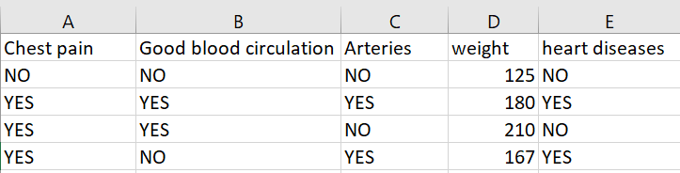
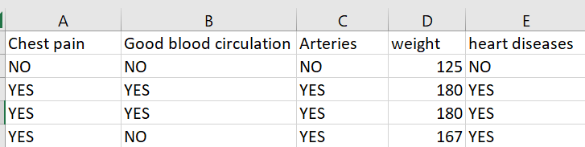
Mathematical implementation of random forest THROUGH AN EXAMPLE:
construct bootstrapped dataset, observe the Randomness involved in constructing the bootstrapped dataset
* Randomness is done with Replacement
Original Dataset

Slide 14
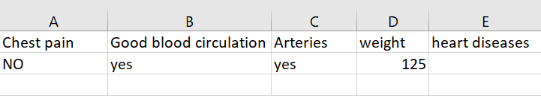
2 Construct Decision Tree using Bootstrapped Dataset:
* while constructing decision Tree the candidate for root node and rest of the root nodes can be randomly selected.
* For instance among, “chest pain”, “Good blood circulation”, Blocked Arteries and “weight”
* “Blocked Arteries” & “weight” can randomly be selected and best of two can be used as the root node. At each step of tree construction two random candidated can be selected this way
3 Repeat step 1 and step 2.
In order to get more number(or required number of Decision Tree)
4. Now its time to test !
lets say we have

Slide 15
Run this on each of the decision Tree
Take the decision given by the majority of the trees.(if 5 “yes” and 2 “no”, then the patient has “heart diseases”).
This method taking many base learners(i.e) decision trees and aggregating the decision of the majority population is called “Bagging”
The Randomness involved in the training data make the random forest classify more accurately the “in seen test data set”
Therefore yielding low variance compared to decision tree.

Slide 16
Examples
The problem statement is that looking to buy a house, but you’re unable to decide which one to buy. For this reason, you visit the agent and give you the list of parameters that will help you to consider before buying a house. The list of parameters are:- House Price, Number of bedrooms, parking space, locality, available facilities.
Let’s form a single decision tree

Slide 17
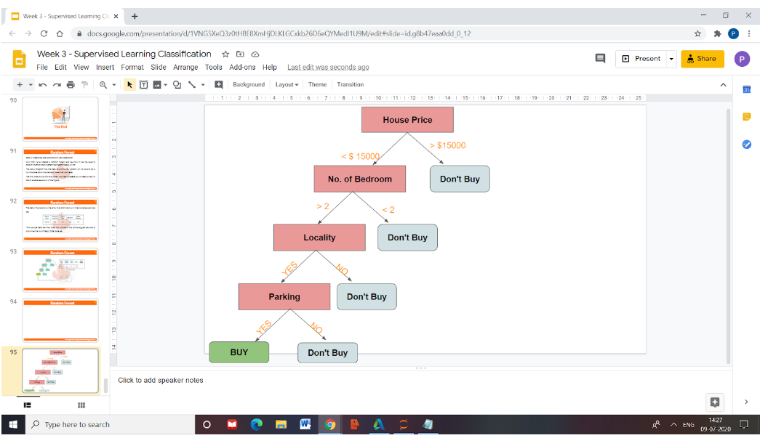
Now earlies said that Random forest is formed multiple decision tree it randomly selected the set of parameters for each different decision tree.

Slide 18
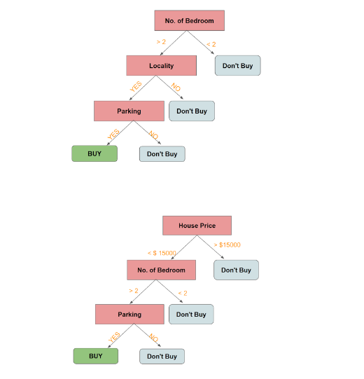
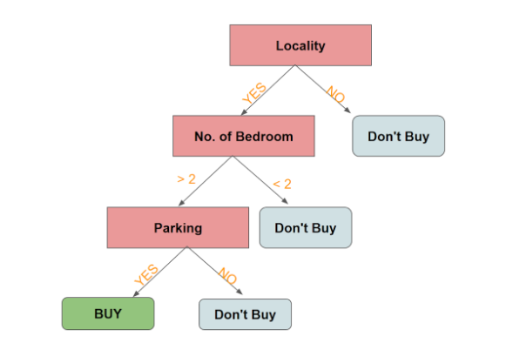

Slide 19
Here we have created multiple decision trees i.e. 3 With using given 3 parameters in the dataset. Each decision tree predicts some output from data a variable and we get the aggregate of that value to predict the outcome in the random forest.
In Simple words after building the model of the random forest it to get the prediction to take majority value in case of classification and aggregate in case of regression.
So this is also a difference between Decision tree and Random Forest

Slide 20
The Mathematics Behind Random Forest
Gini Index :
Method to split out the data is the Gini index, it checks the impurity or purity of data it is used in the CART( Classification and Regression Tree) algorithm like Decision Tree.
It creates a binary split and the CART algorithm uses it to create a binary split.
An attribute is low Gini index is preferred as the root node

Slide 21
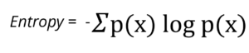
Formula to calculate Gini index is:-
Gini Index= 1- ∑jPj2
Information Gain :
Information gain is calculated with the use of entropy in the data set and the attribute entropy, It gives us information about how much information a feature provides us with a class.
Entropy measures the impurity or randomness is present in the given data. It is used to decide the root node in the decision tree to split out the data.
Formula to calculate information gain
Information Gain= Entropy(S)- [(Weighted Avg) *Entropy(each feature) ]
Highest the information gain we select that feature as the root node

Slide 22
When to use entropy and Gini impurity
Entropy and Gini impurity both tell how the pure split with any feature.
But Gini impurity is better than entropy let us take with an example.
Gini impurity is more computational then entropy

Slide 23
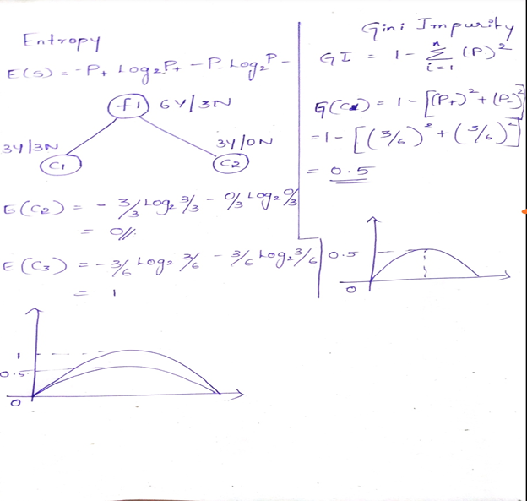

Slide 24
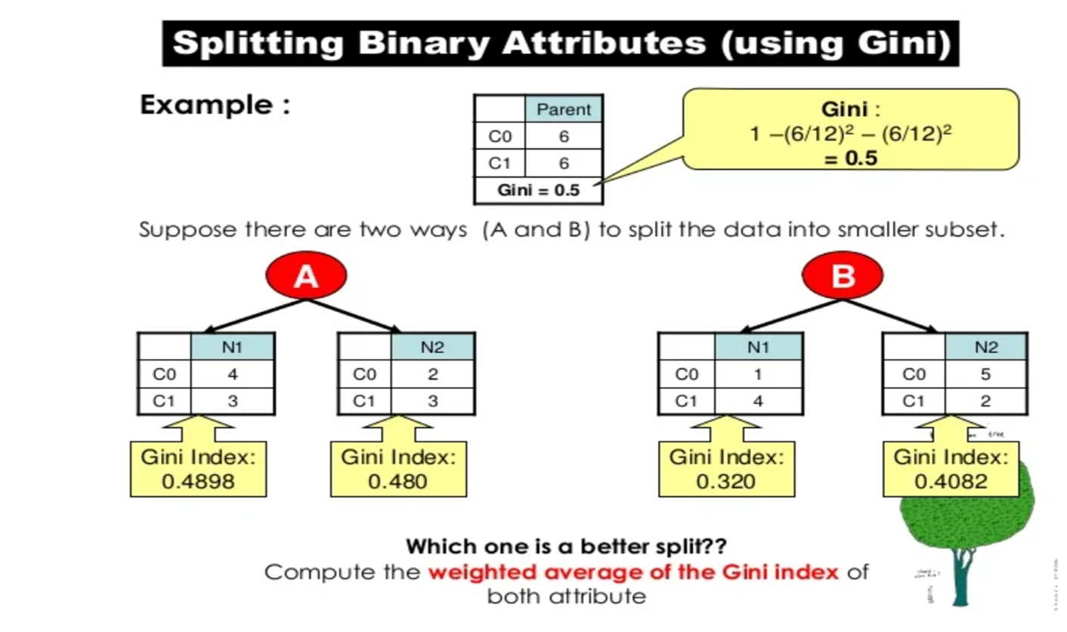
A Gini score gives an idea of how good a split is by how mixed the classes are in the two groups created by the split. A perfect separation results in a Gini score of 0, whereas the worst case split that results in 50/50 classes. We calculate it for every row and split the data accordingly in our binary tree. We repeat this process recursively.

Slide 25
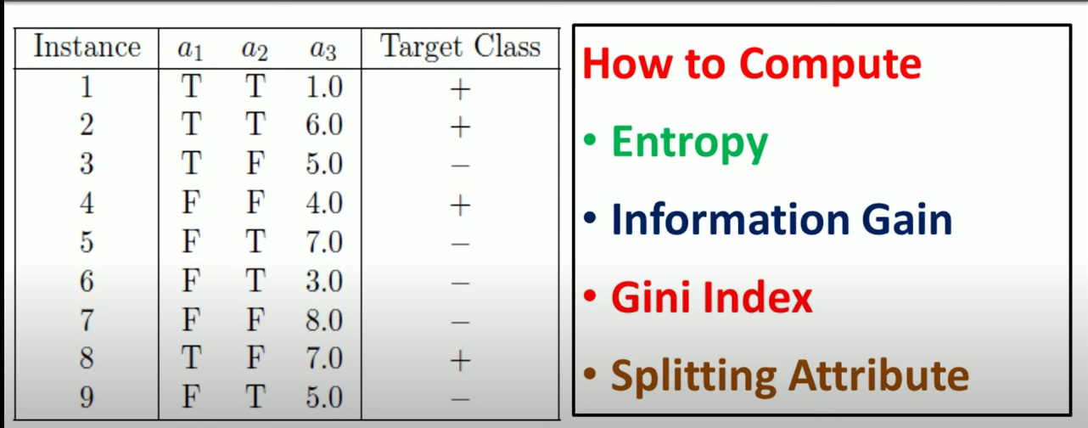

Slide 26
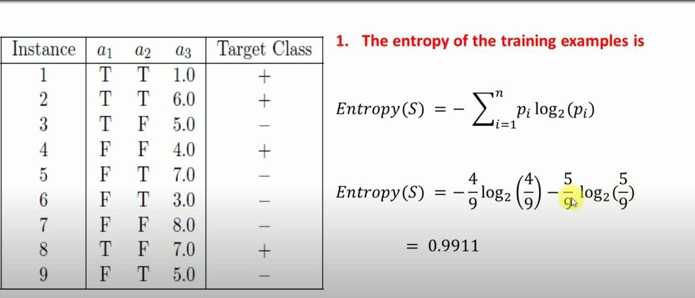
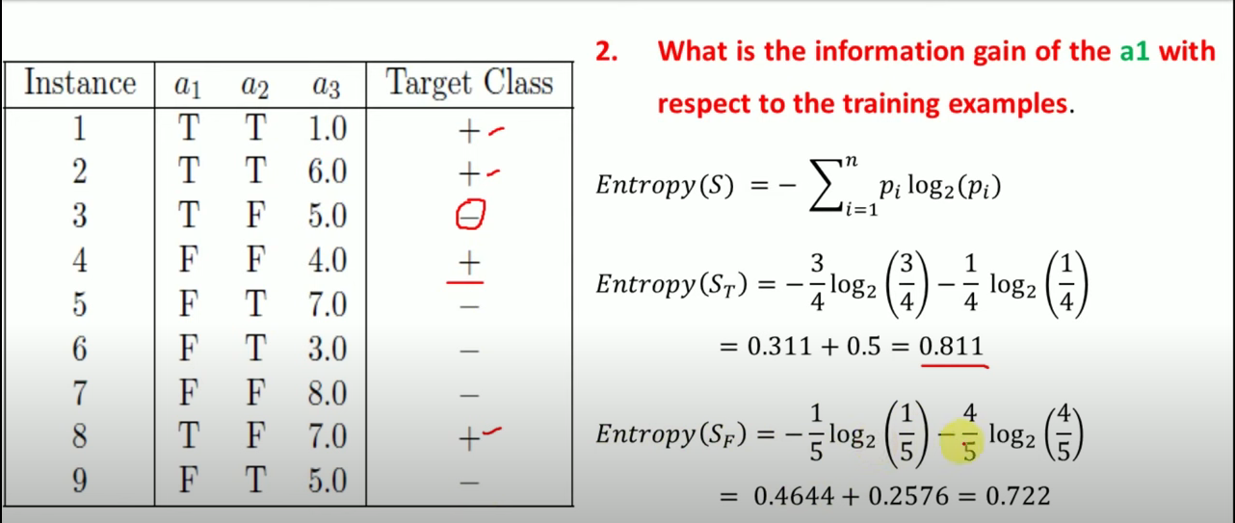

Slide 27
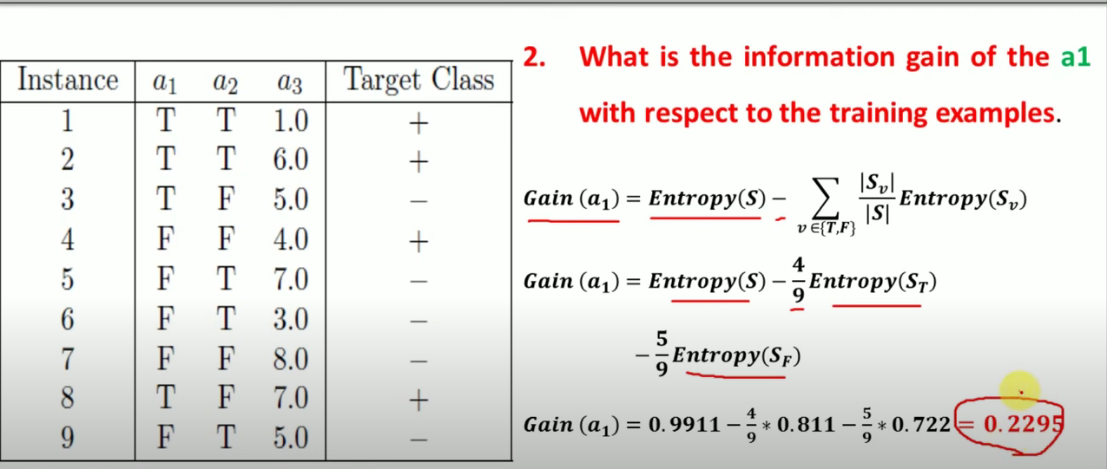
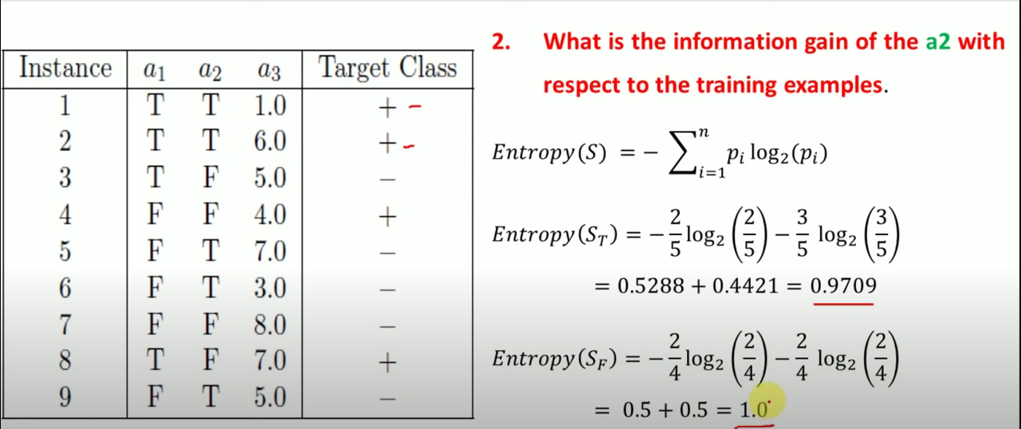

Slide 28
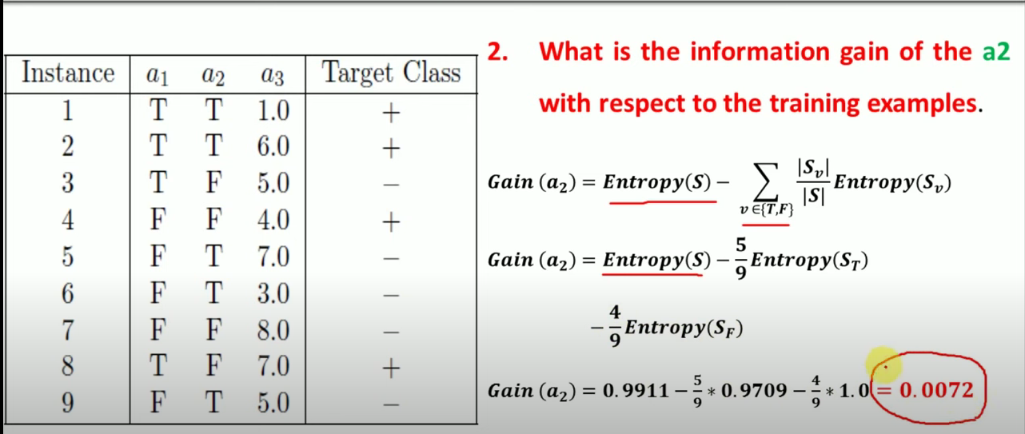
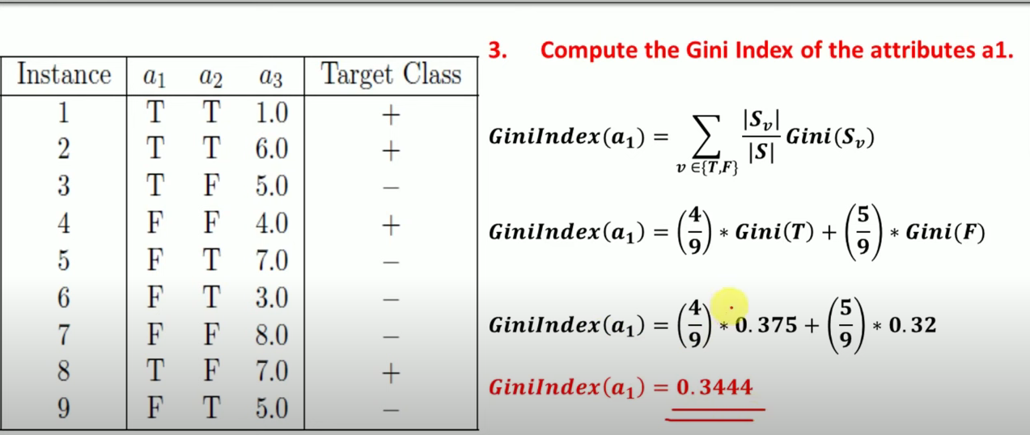
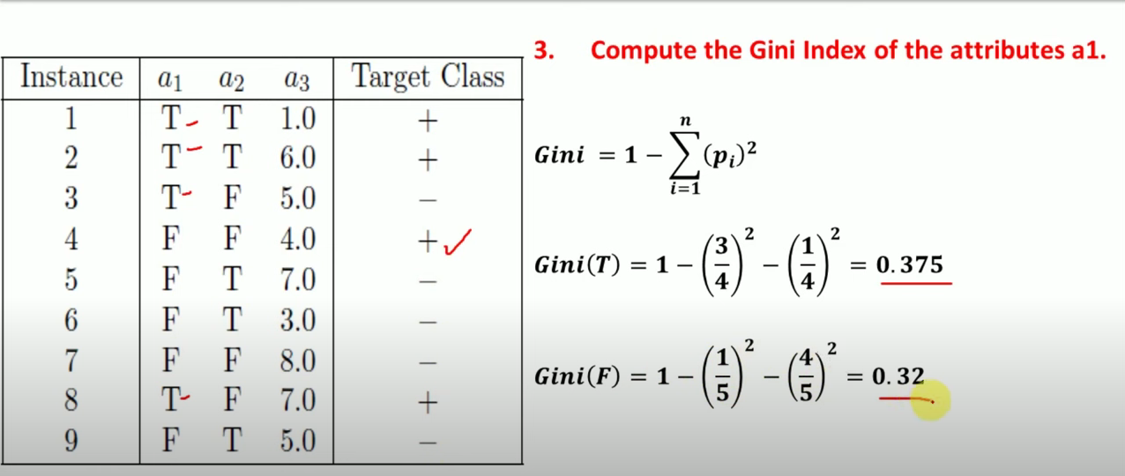
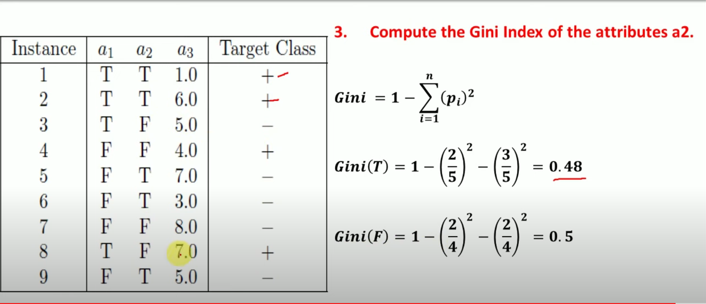

Slide 29
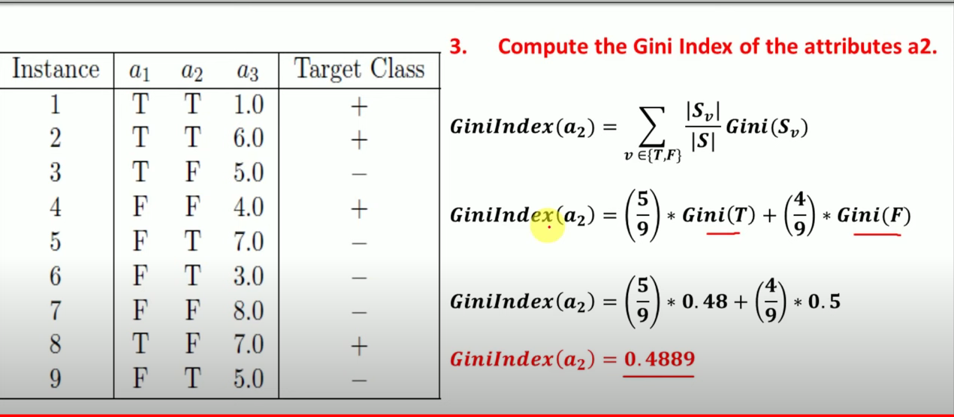
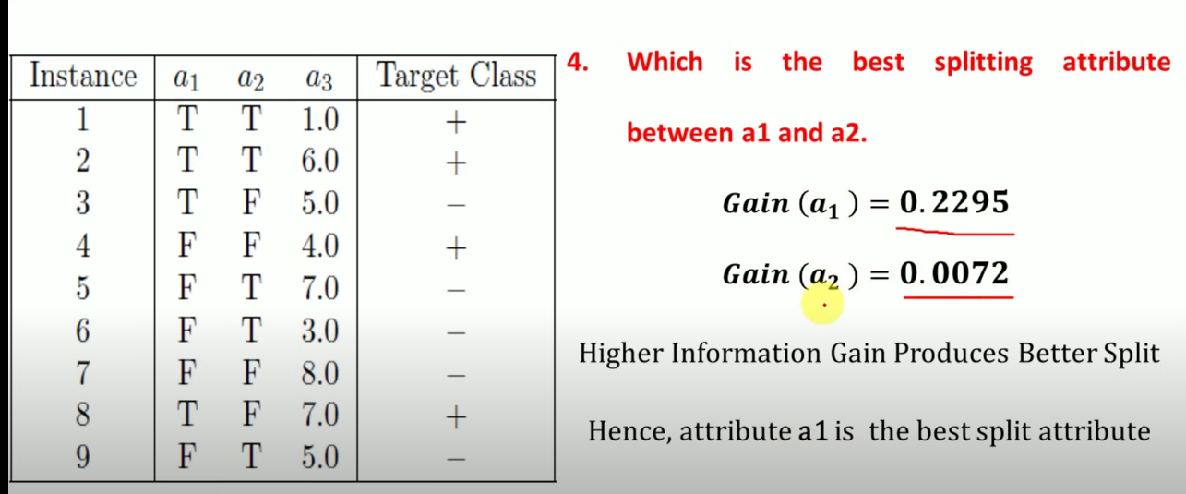

Slide 30
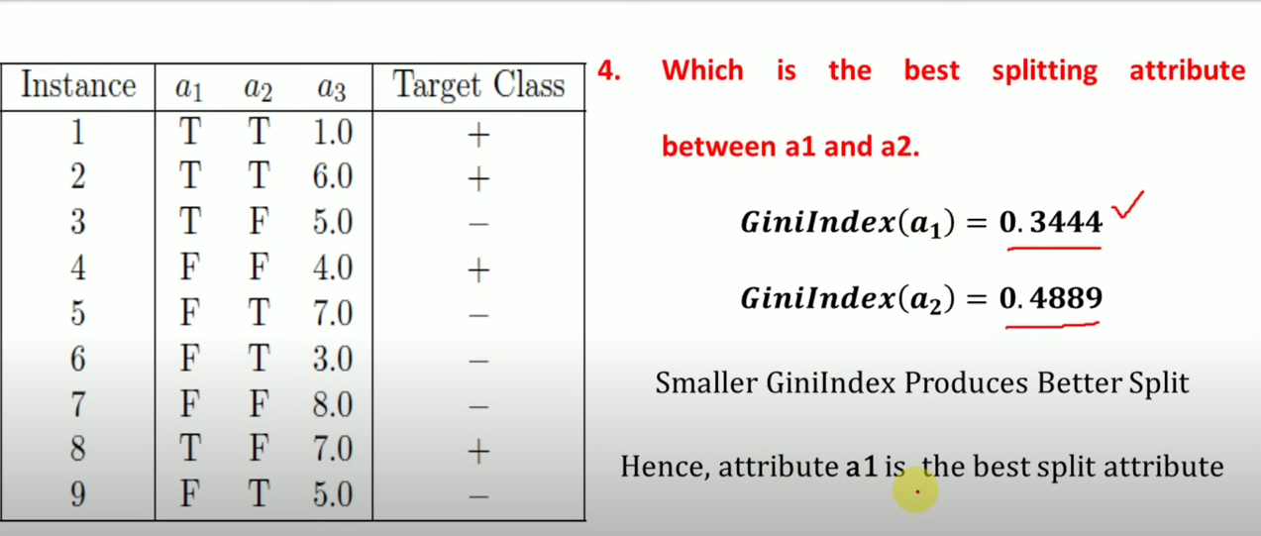

Slide 31
Pros of Random Forest
It is used for both Classification and Regression tasks.
It handle large dataset with high dimensionality.
Improve the accuracy of the model and prevents model to overfitting issue
CONS OF RANDOM FOREST
Slow prediction time once the model is created
it is not more suitable for Regression tasks.

Slide 32


